Slide 1
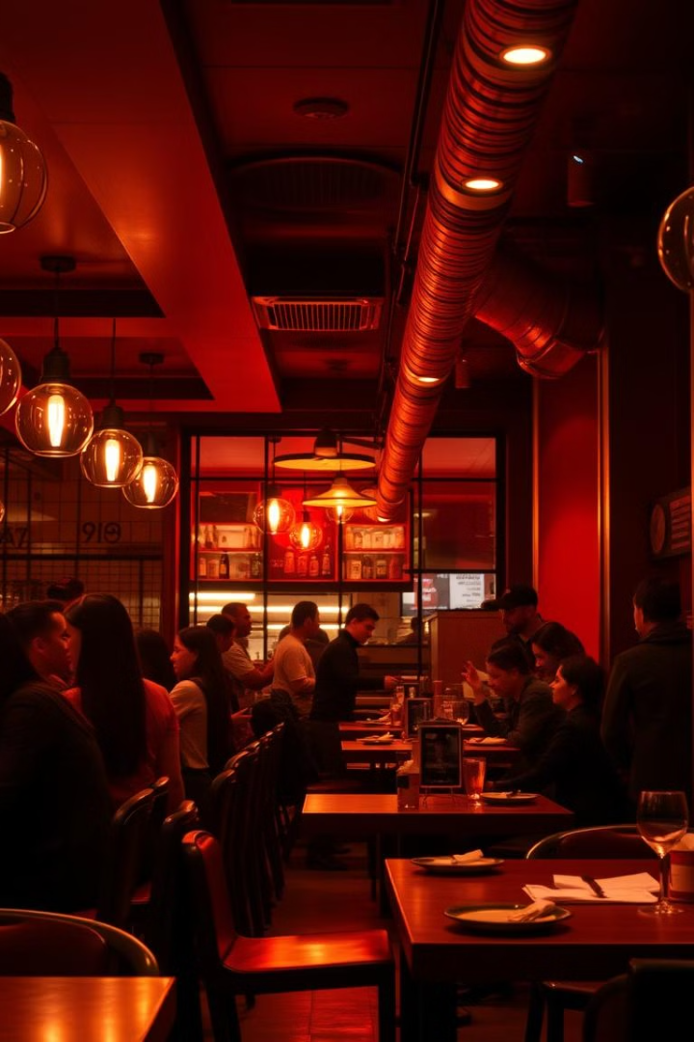
MIS Implementation: Streamlining Restaurant Operations
This presentation outlines the implementation of a Management Information System (MIS) for restaurant operations. We'll cover order processing, inventory management, and customer feedback. Our goal is to enhance efficiency and reduce costs through effective data management.
tt
by thrinath thota

Slide 2

Abstract: Achieving Cost-Effective Inventory Management
This project aims to design and implement a cost-effective inventory management system. It leverages DBMS and SQL to optimize resource allocation. The system will minimize food wastage and streamline ordering processes.
Real-time data
Waste reduction
Track inventory in real-time.
Reduce food waste.
Cost savings
Cut operational costs.

Slide 3
Problem Statement: Food Wastage and Inefficient Processes
Many restaurants face challenges with food wastage. Inefficient inventory management leads to spoilage and financial losses. Manual processes are time-consuming and prone to errors, impacting profitability.
Manual errors
Spoilage
High costs
Human error in inventory tracking.
Excess food expiring before use.
Increased operational expenses.

Slide 4





System Architecture: DBMS and SQL Integration
The MIS will be built using a robust DBMS (Database Management System). SQL will be used for data retrieval and manipulation. This ensures data integrity and efficient querying capabilities.
Data Input
Order and inventory data entry.
DBMS Storage
Secure database management.
SQL Queries
Efficient data retrieval.
Reporting
Insightful analysis and reports.

Slide 5

Order Processing and Inventory Management Module
This module will automate order processing from placement to fulfillment. Real-time inventory tracking ensures optimal stock levels. Automated alerts prevent stockouts and overstocking.
1
Order Placement
Customer places an order.
2
Inventory Check
System verifies stock.
3
Order Fulfillment
Order is prepared and delivered.
4
Inventory Update
Stock levels are adjusted.

Slide 6
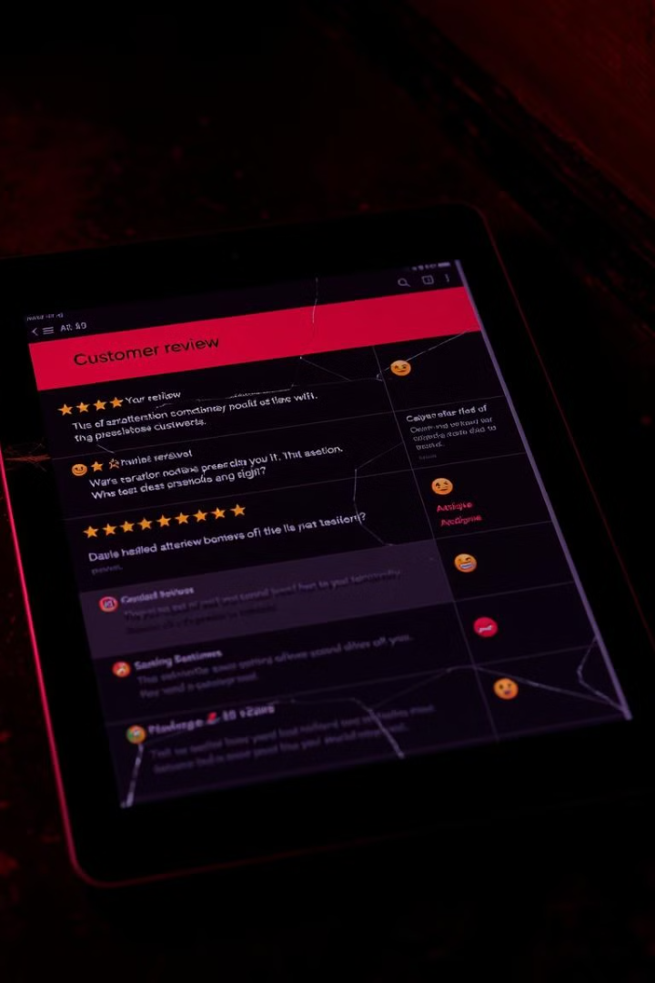



Customer Feedback Tracking and Analysis
The system will collect and analyze customer feedback from various sources. This data will be used to improve service quality. Sentiment analysis identifies areas for improvement.
Feedback collection
Sentiment analysis
Service enhancement
Gather customer opinions.
Identify trends and issues.
Improve customer experience.

Slide 7
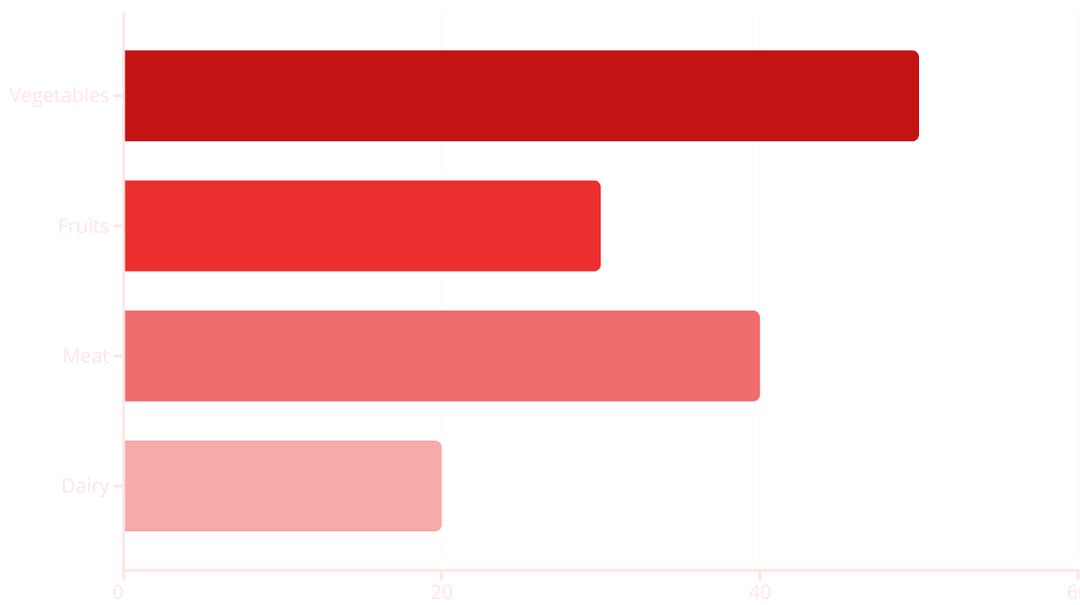
Report Generation: Food Wastage Analysis and Trends
The MIS will generate reports on food wastage patterns. These reports will identify trends. They will also help to pinpoint areas where waste can be minimized.
Report shows wastage per food category.

Slide 8

Outcome: Enhanced Efficiency and Reduced Costs
Successful MIS implementation will result in significant cost savings. Enhanced efficiency in order processing. Reduced food wastage. Improved customer satisfaction.
30%
20%
Cost Reduction
Waste Reduction
Lower operational costs.
Minimize food spoilage.
15%
Efficiency Gain
Faster order processing.

Slide 9
Key Takeaways
MIS implementation streamlines restaurant operations.
It reduces food wastage through effective tracking.
It enhances customer satisfaction via feedback.
DBMS and SQL enable efficient data management.
Report generation supports informed decision-making.

Slide 10

Next Steps
We recommend proceeding with system design. It's also important to begin database setup. Data migration planning is necessary. User training will be crucial for success.
System Design
Database Setup
Data Migration
User Training

